Slide 1


Slide 2



This course material by Osama Salah is released under the following license:
Attribution-ShareAlike 4.0 International (CC BY-SA 4.0)
Conditions for use are published here:
https://creativecommons.org/licenses/by-sa/4.0/

Slide 3
Acknowledgement
I would like to thank and acknowledge the following people for their valuable contributions to this course material:
Have your name and effort acknowledged here!!!

Slide 4
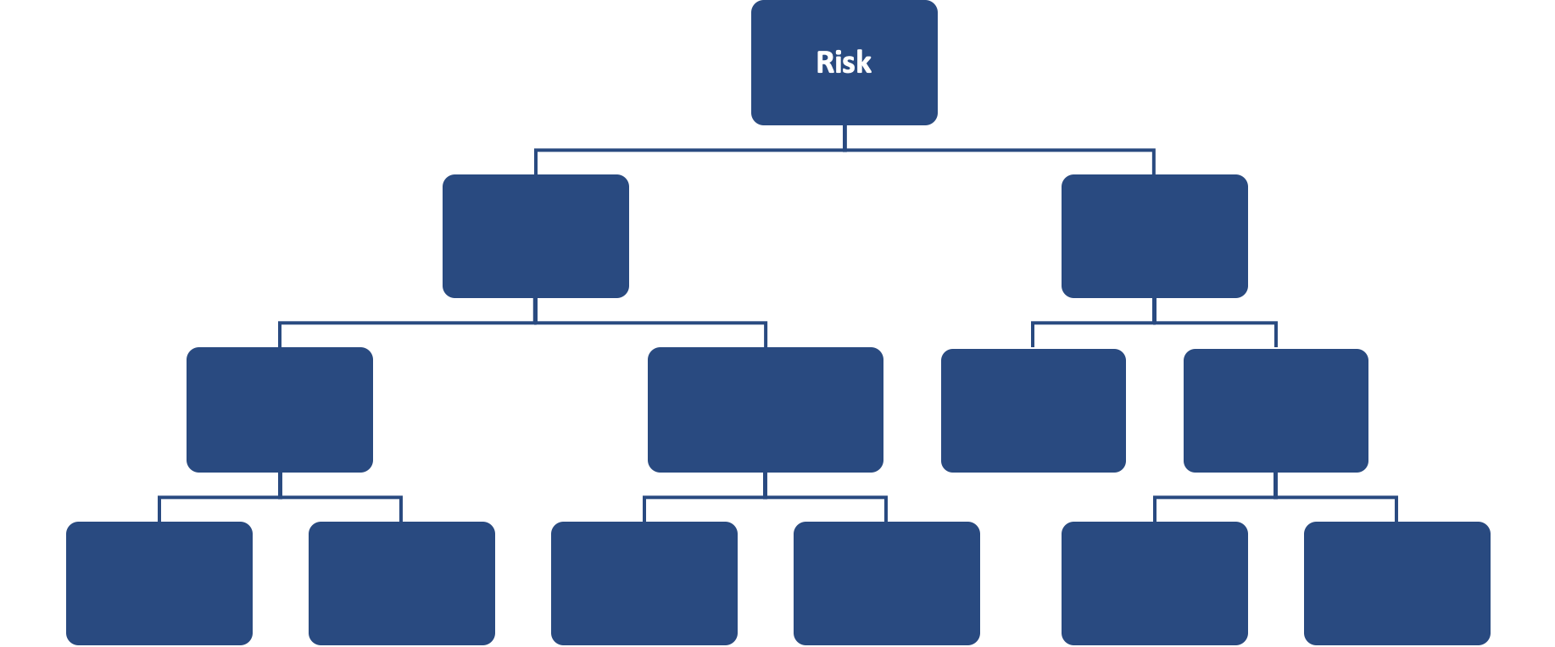
FAIR Open Course Module 5 – Running the Simulation Ver. 0.1 / Last Update: 14/09/2019

Slide 5
FAIR RISK ANALYSIS
Module 5 Running The Simulation

Slide 6
Summary of Estimates
LEF
Min | ML | Max
2 | 3 | 5
Primary Losses
Productivity (employee idle time) | $34,560 / $64,800 / $115,200
Replacement | $2250
Response | $9,600 / $12,800 / $16,000
SLEF (%)
Min | ML | Max
2% | 3% | 5%
Secondary Loss Magnitude
Reputation | $300K, $450K, $900K

Slide 7

Running the Simulation
We will be using the free FAIR-U app: https://app.fairu.net
If you have not created an account please do
Notes on data Entry:
Click on “Loss Event Frequency” to enable input on that level, since we will not be using TEF and Vulnerability
For Loss Magnitude types that will not be used enter “0”
Run the Analysis

Slide 8
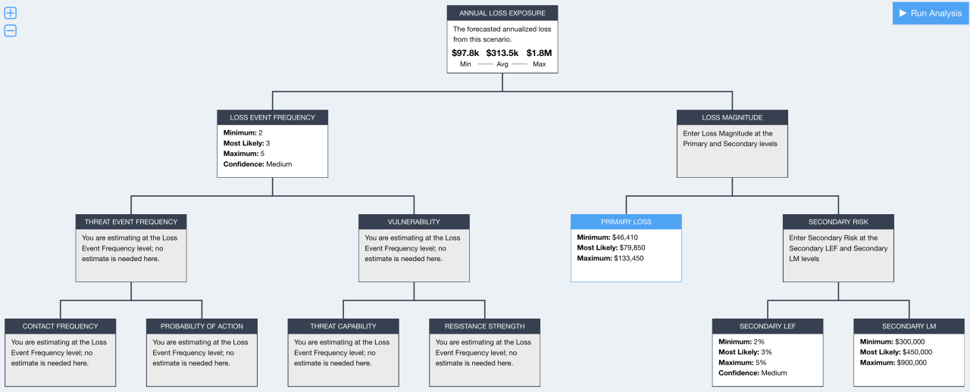
Analysis Input and Results

Slide 9
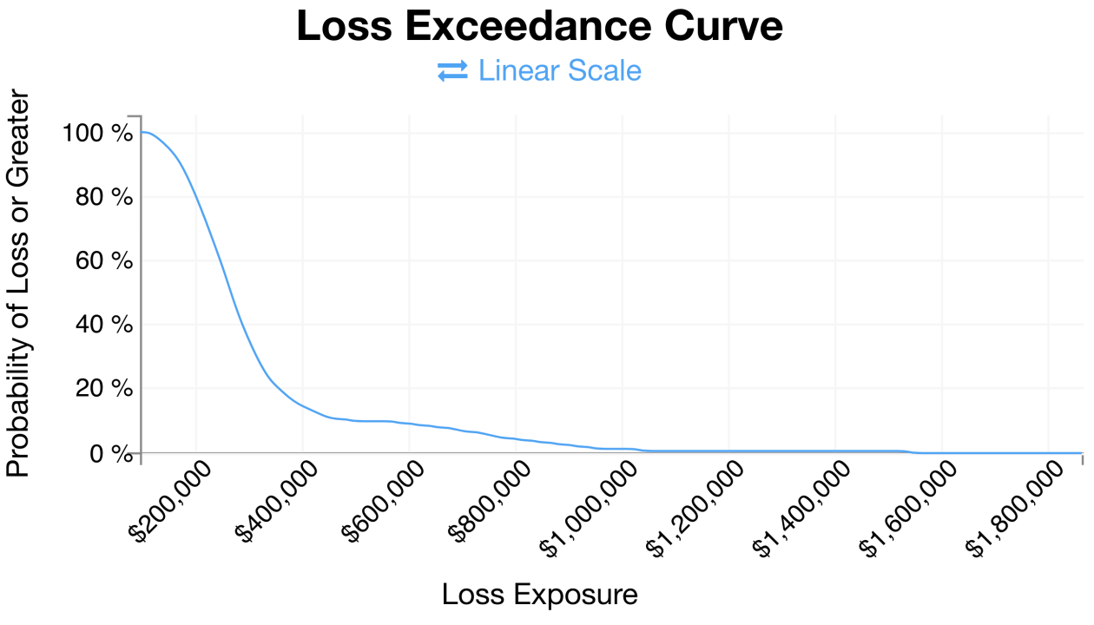

Notes:
Explain the Axis:
X-Axis: Annualized Loss Exposure from Minimum $72.1K to Max $1.8M
Y-Axis: Probability of Loss equal or greater than given loss exposure (X-Axis)

Slide 10
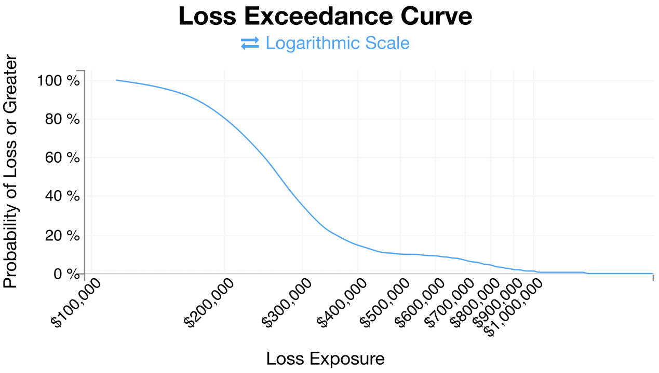

Slide 11
20% probability of a loss >= ~$370K

Slide 12
?
What if the organization does not want to take any risk in regards to this scenario? How much would its insurance coverage need to be?

Slide 13
Re-Running the Same Simulation
?
Can you explain why we do get slightly different results when we re-run the simulation or why the results of other students differ from yours?

Slide 14
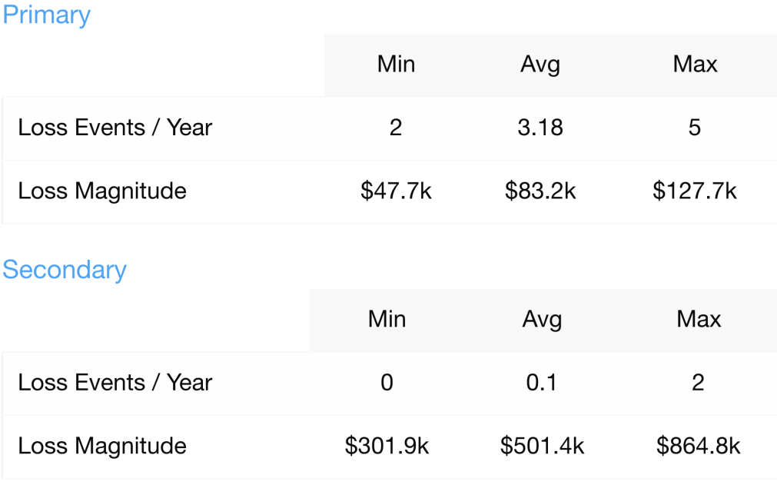
Event Summary (Non-Annualized)
!
Loss events per year.
!
Forecasted loss per event.
Notes:
Annualized Presentation: Useful when we have multiple events per year and when comparing scenarios.
Per Event: Useful when less than one event per year
We can also see that Secondary Loss Magnitude is the major contributor to our risk exposure.

Slide 15
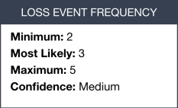
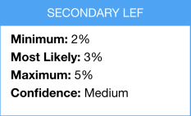
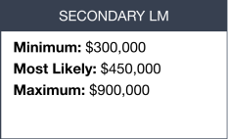
!
Values shown are not our estimates but the actual values used in this particular simulation or resulting from the simulation.
Our SLEF estimates were percentages and changed into frequencies.

Slide 16
Interested in the math?
If you are interested in the math behind all the calculations, checkout:
OPEN FAIR™ TOOL WITH SIPMATH™ DISTRIBUTIONS: GUIDE TO THE THEORY OF OPERATION - REFERENCE: G181
“This document defines the algorithms that can be used to produce an acceptable implementation of the Open FAIR™ Risk Analysis (O-RA) standard, a standard of The Open Group.”
https://publications.opengroup.org/g181

Slide 17
Thinking about treatment plans
Now that we have a good understanding of the risk, we need to think about the treatment plans.
We can propose controls that will impact Loss Event Frequency, Loss Magnitude or both.

Slide 18
Treatment option 1: Upgrade Endpoint Security
One proposed treatment option is to replace our “traditional antivirus” solution with a modern “Next generation Endpoint protection” solution.

Slide 19
Treatment option 1: Upgrade Endpoint Security
Replacing AV with “Next generation Endpoint protection” will have what impact?
Risk
Loss Event Frequency
Threat Event Frequency
Vulnerability
Loss Magnitude
Primary Loss
Secondary Risk
Secondary Loss Event Frequency
Secondary Loss Magnitude
Contact Frequency
Probability of Action
Threat Capability
Difficulty

Slide 20
Treatment option 1: Upgrade Endpoint Security
Although the proposed treatment impacts vulnerability, our analysis did not specifically include vulnerability as we directly estimated LEF.
SMEs have researched NGAV solutions and found its detection and prevention capabilities to be superior to our current solutions. They make the following estimates for NGAV.
 | LEF
 | Min | ML | Max
AV | 2 | 3 | 5
NGAV | 1 | 1 | 2

Slide 21
Re-Run the Simulation
FAIR-U does not have a feature to compare two simulations, so we need to improvise:
We make a copy of our simulation scenario.
Make the changes and re-run the simulation.

Slide 22

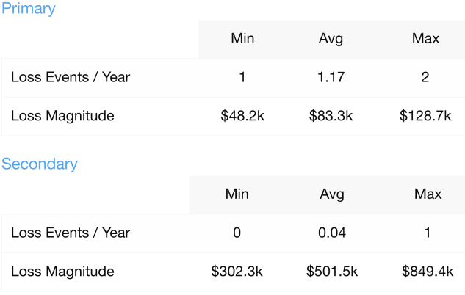
After treatment
?
Compare and discuss the changes. What changed, what didn’t and why?

Slide 23
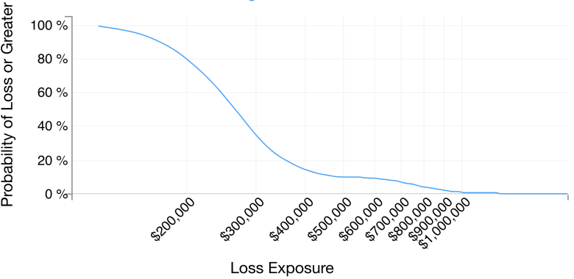
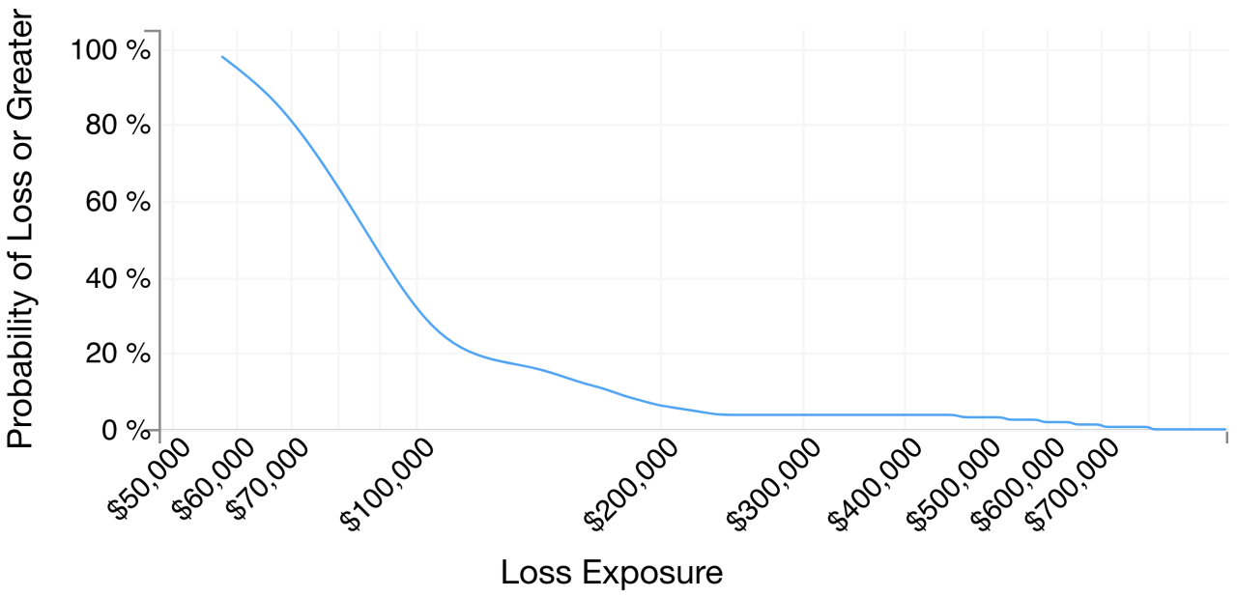
Before Treatment
After Treatment
$370K
$125K

Slide 24
Comparing The Options
Original Scenario: ~20% probability loosing more than $370K
Treatment Scenario: ~20% probability of loosing more than $125K
Assuming the original risk was unacceptable and the treatment plan is acceptable then this implies that we justify spending up to $245K (annually) on the risk treatment plan ($370K-$125K)

Slide 25
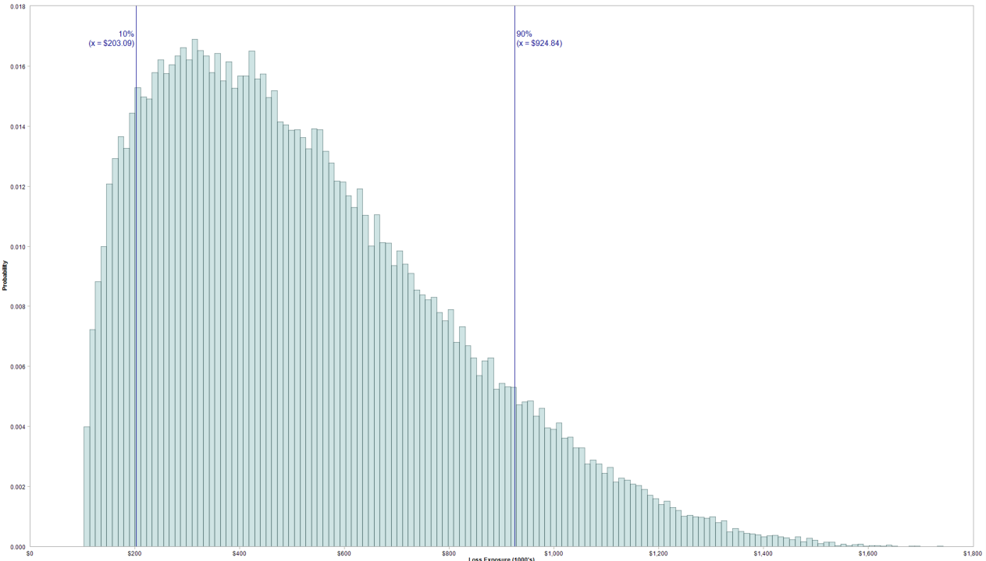
ML
$667K
Avg
$526K
②
③
④
①
80% of simulated results between ① and ④ (10th to 90th Percentile)
On average simulated results are around ③ $526K
The most likely (most often occurring) result was around ② $667K
Notes:
Fair-U only used the loss exceedance curve simulation. The probability distribution in this image is another visualization option. This one is only simulated using ModelRisk and the end results of our simulation.

Slide 26
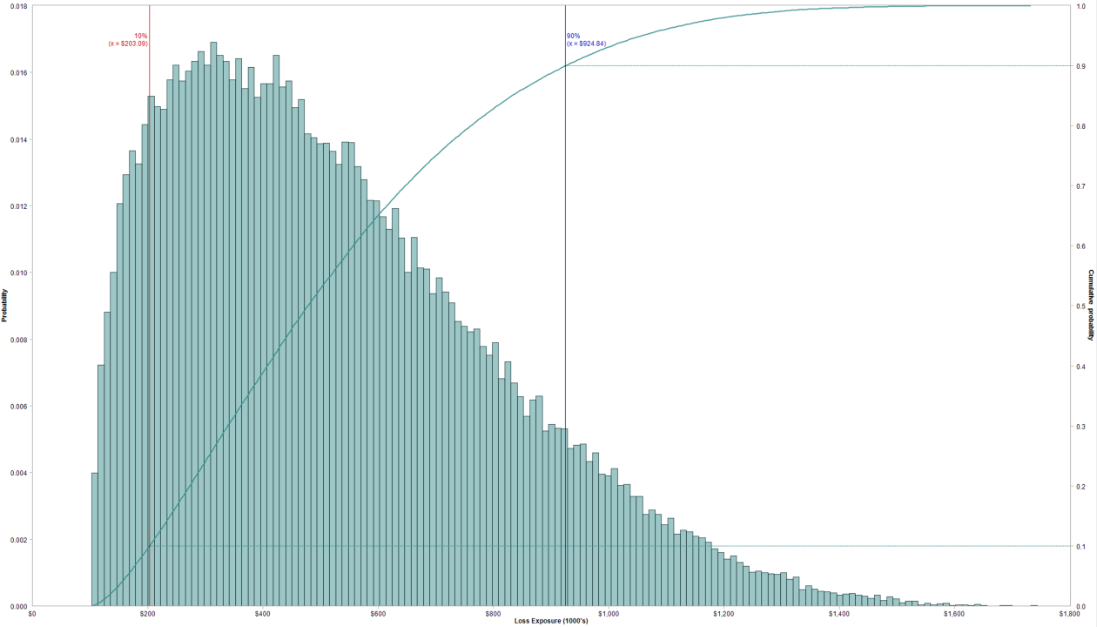
Notes:
The same visualization with the cumulative probability overlaid.
We can pick a percentage on the Cumulative probability axis on the right and map to the corresponding loss exposure.
For example for 90% it would be $924K i.e. 90% of the loss exposures are below $924K.

Slide 27
Let’s simulate more treatment plans
Run more variations of this scenario by proposing other treatment plans, for example:
Implementing a new cloud service that has an “instant” ransomware restore function (admin centrally restores quickly any file changed in a given time frame to all users).
Deploy a “controlled folder” solution that allows only approved processes to modify files in specified folders and denies access to any other process.
Discuss the impact of the treatment plans, risk reduction and cost benefit analysis.

Slide 28
Refining the scenario
Once you start a simulation you might get new ideas and usually it’s quite easy to update the simulation accordingly, for example:
What if more than just 50 endpoints are impacted? Even if they don’t support critical processes they will eventually have to be recovered.
Will all 500 be impacted or can we estimate a range?

Slide 29
Other Free Tools

Slide 30
Warning
The tools will give slightly different results due to the variations in the implementation of mathematical modelling and distribution types used.
This basically means that in absence of an independent evaluation of the inner workings of the tools we will need to use our own judgement on which tools to trust or have more confidence in its results.
This also means that the results shown should be viewed as “guidelines”, there is always a margin of error or uncertainty. As we already mentioned at the beginning precision isn’t our prime objective.

Slide 31
THE OPEN FAIR™ RISK ANALYSIS TOOL
THE OPEN FAIR™ RISK ANALYSIS TOOL BETA (90-DAY BETA EVALUATION LICENSE)
REFERENCE: I181
AVAILABLE TO DOWNLOAD: https://publications.opengroup.org/i181
Downloading the Beta Version of the Open FAIR™ Risk Analysis Tool
The Open FAIR Risk Analysis Tool can be used to perform a quantitative Open FAIR risk analysis as defined in The Open Group Risk Analysis (O-RA) and Risk Taxonomy (O-RT) standards. It is provided in the form of a Microsoft® Excel® spreadsheet.
The Beta version of the Open FAIR Risk Analysis Tool is available to all to download free-of-charge for non-commercial use. That will usually mean using it inside your organization. To use the Open FAIR Risk Analysis Tool for commercial purposes, a Commercial License will be made available with version 1.0 of the tool

Slide 32
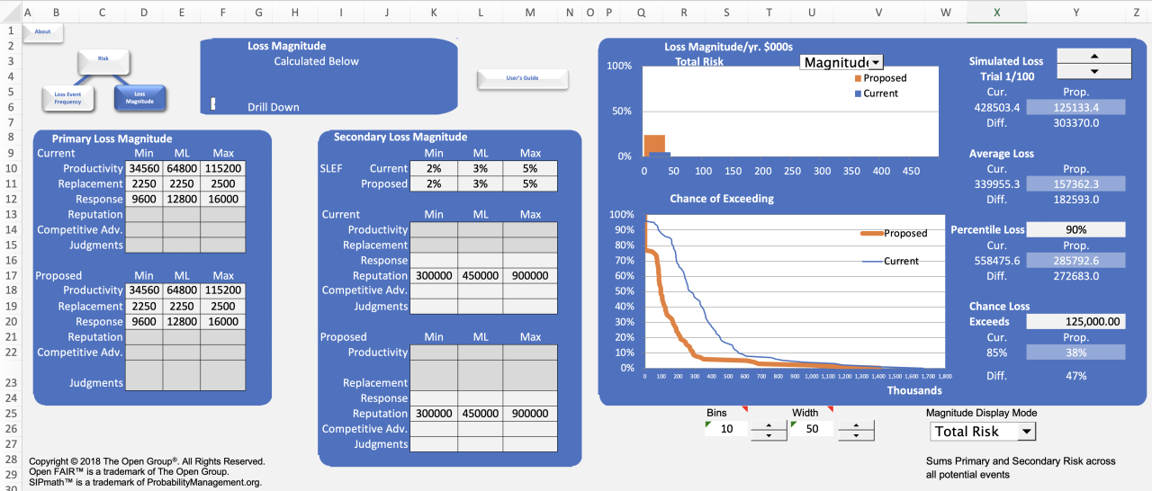
!
Try the Open Group tool and compare and discuss results with the FAIR-U Simulation.

Slide 33
Other Tools (not discussed)
evaluator by David Sverski: https://evaluator.tidyrisk.org/
“evaluator is an open source quantitative risk analysis toolkit. Based on the OpenFAIR ontology and risk assessment standard, evaluator empowers an organization to perform a quantifiable, repeatable, and data-driven risk review.”
FAIR Tool developed by Ezeugo Aguta
https://github.com/zugo01/FAIRTool
http://www.ezeugoaguta.com/fair.html

